Slide 1
02 Dynamic Programming + Monte Carlo method

Slide 2

This tutorial is mainly contributed by…
Github
方泽鸣，zemingfang11@gmail.com
张洳源，ruyuanzhang@gmail.com
张洁莹，jieying.zhang@student.uva.nl
部分内容由张洳源老师正在编写的教材《认知行为的计算原理》收录： https://ruyuanzhang.gitbook.io/compmodcogpsy

Slide 3
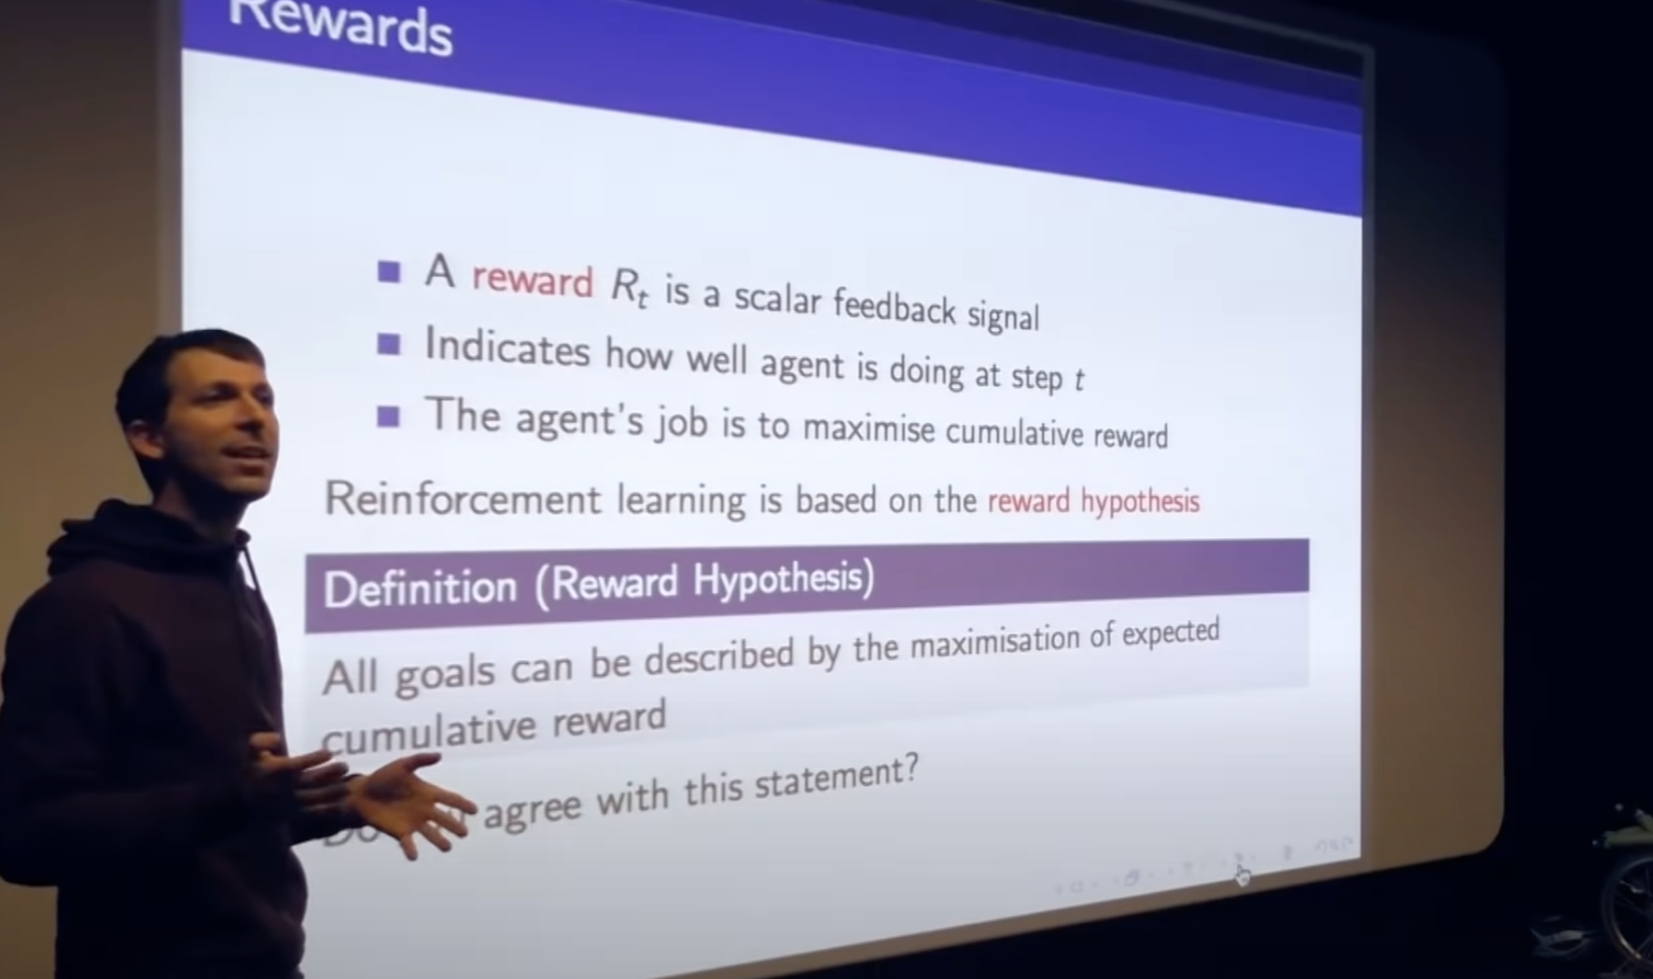
Goal: reward hypothesis

Slide 4
Definition:
Goal:
Model-based
Model-free
A lack of model
Dynamic Programming
Monte Carlo Method
Policy iteration
Value iteration

Slide 5
Overview
Lecture
Monte Carlo control
Temporal Difference prediction
Temporal Difference control
Practice MC control
Sarsa
Q learning

Slide 6
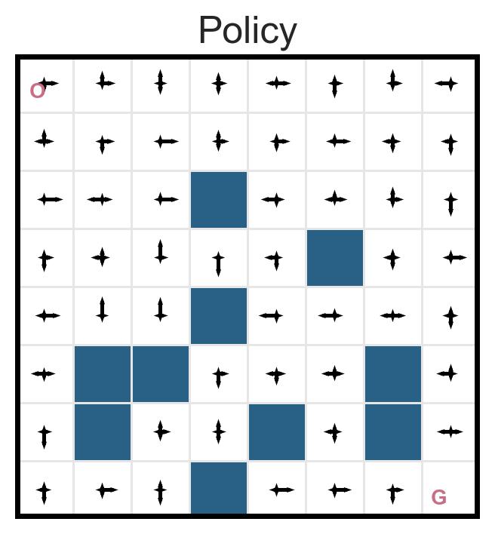
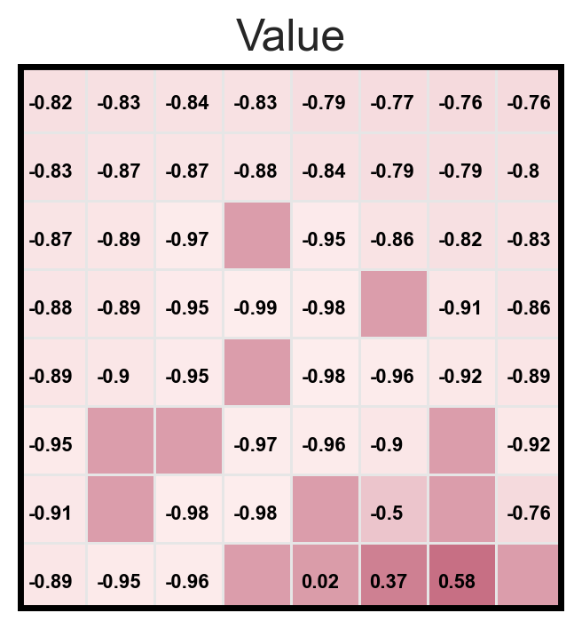
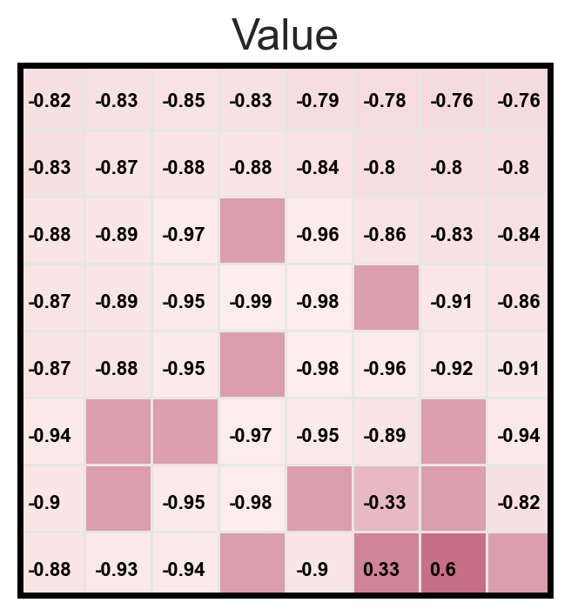
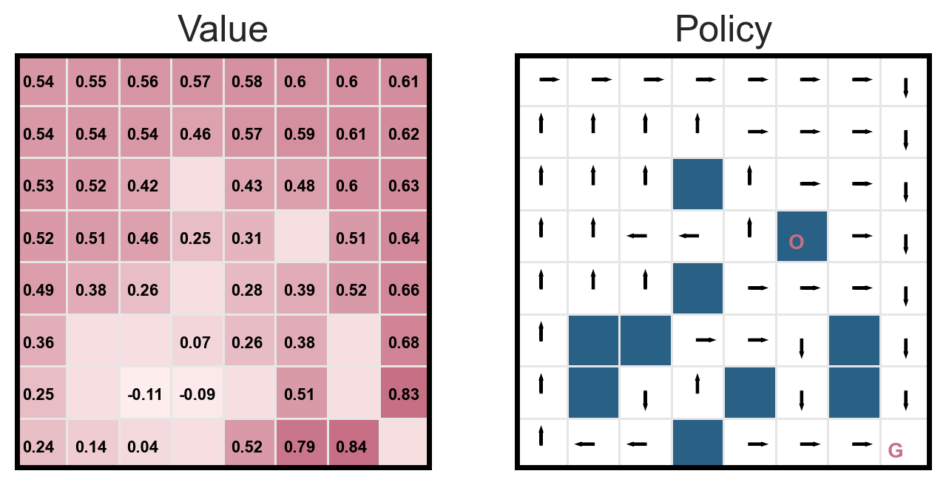
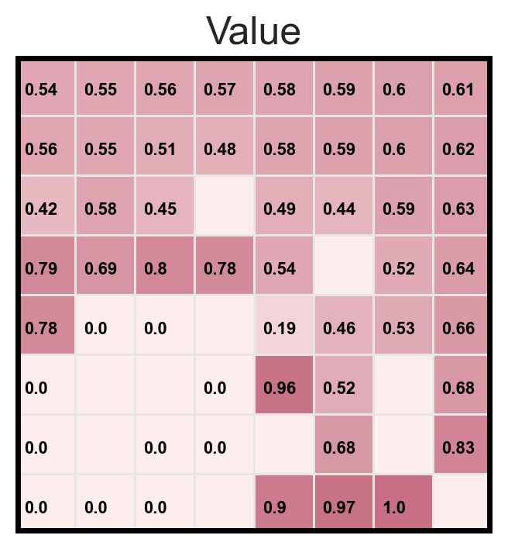
Policy evaluation vs. MC prediction
Policy evaluation
MC prediction
Random policy
Optimal policy
Exploration and exploitation

Slide 7
Overview
Lecture
Monte Carlo control
Temporal Difference prediction
Temporal Difference control
Practice MC control
Sarsa
Q learning

Slide 8
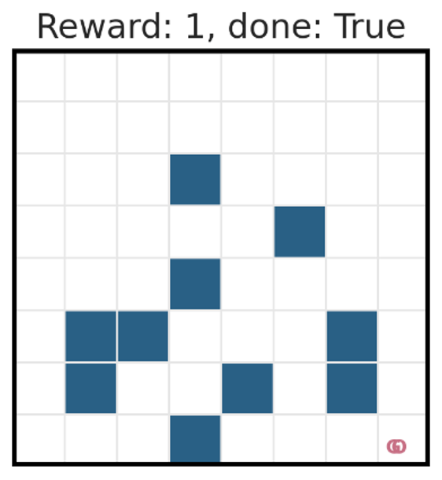
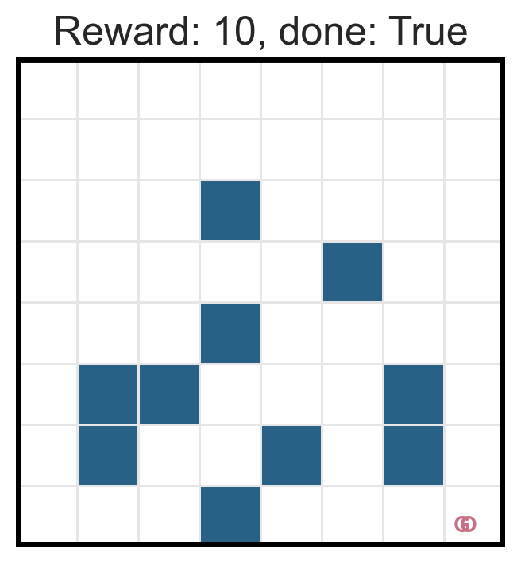
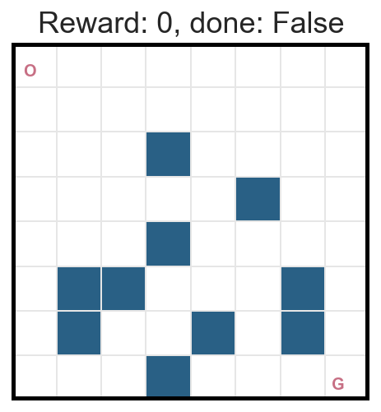
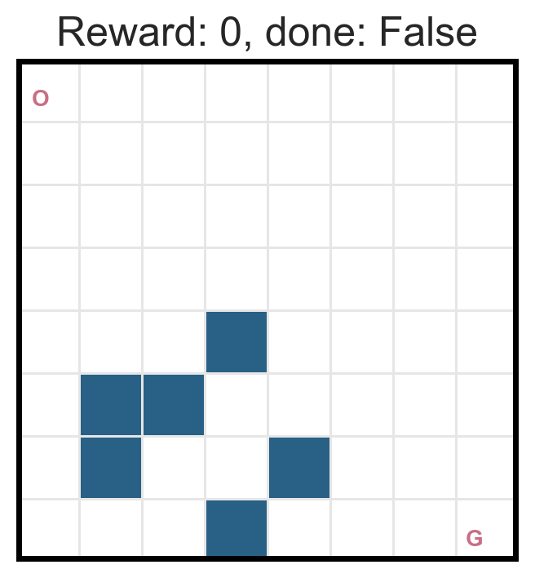
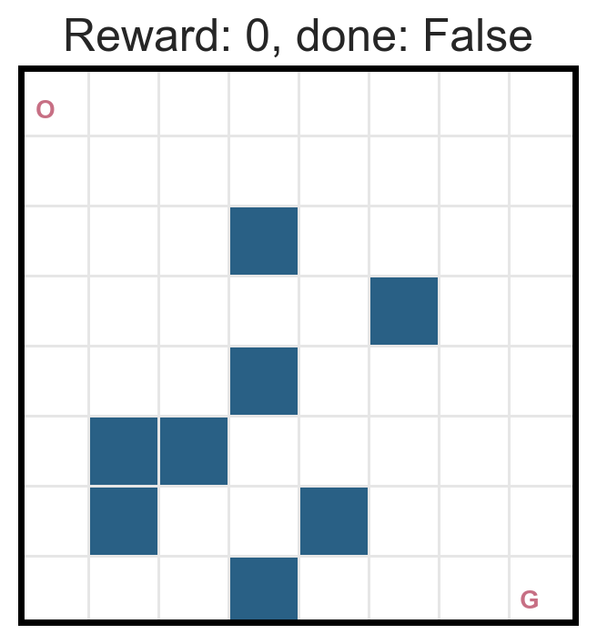
MC method is not an efficient algorithm…
We need to make a few modifications
1. Increased the reward
2. Simplified the layout

Slide 9
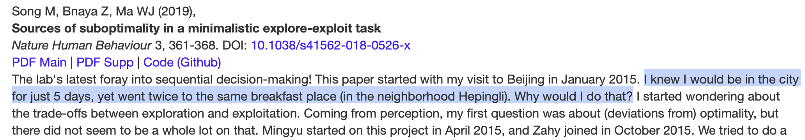

Exploration-exploitation dilemma
The optimality should be based on the correct understanding (value evaluation) of the surrounding environment.

Slide 10
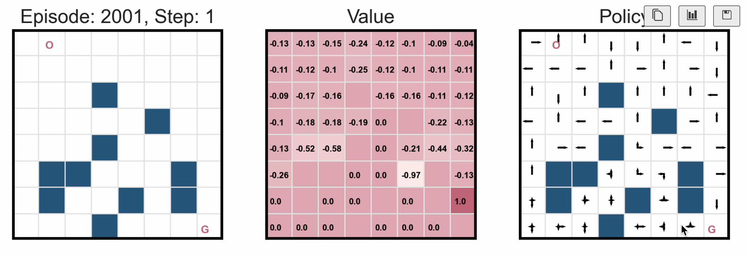
When there is no exploration..

Slide 11
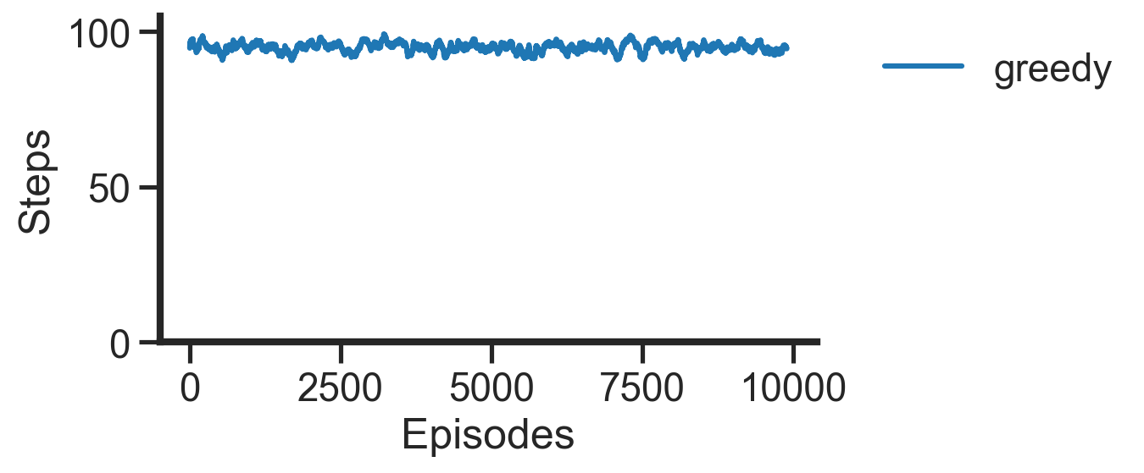
When there is no exploration..

Slide 12
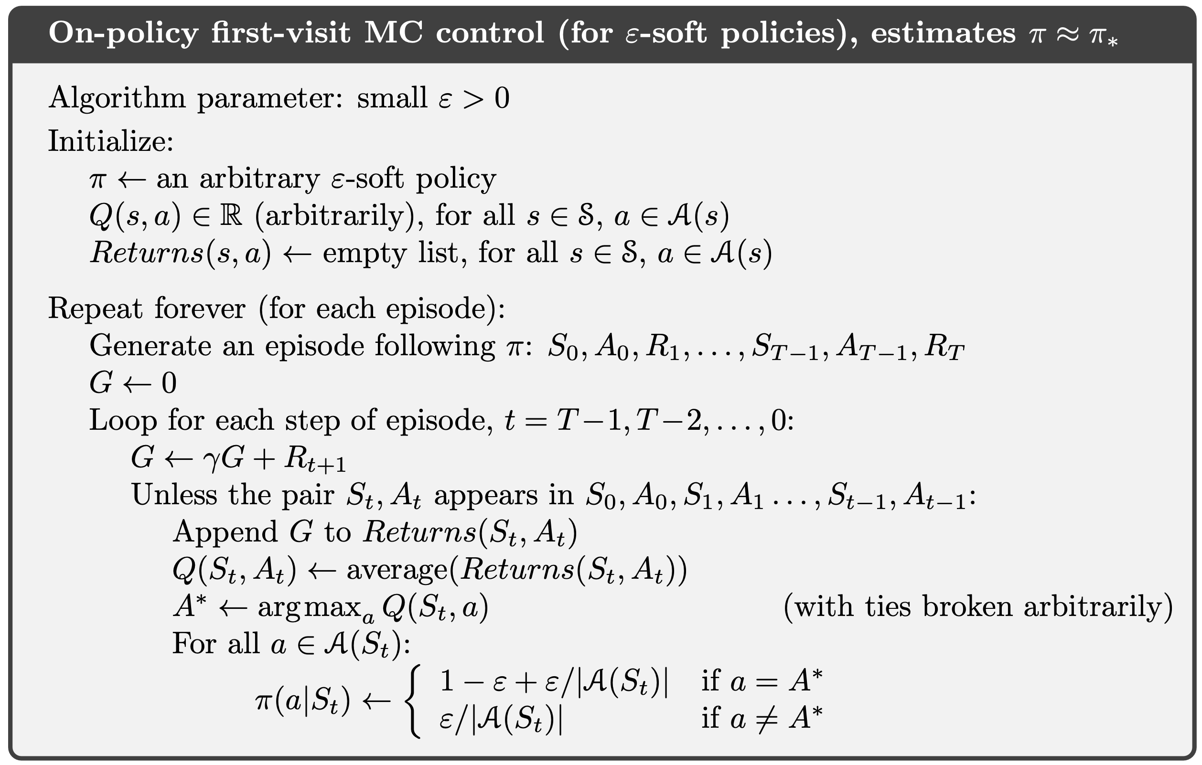
MC control with epsilon-greedy

Slide 13
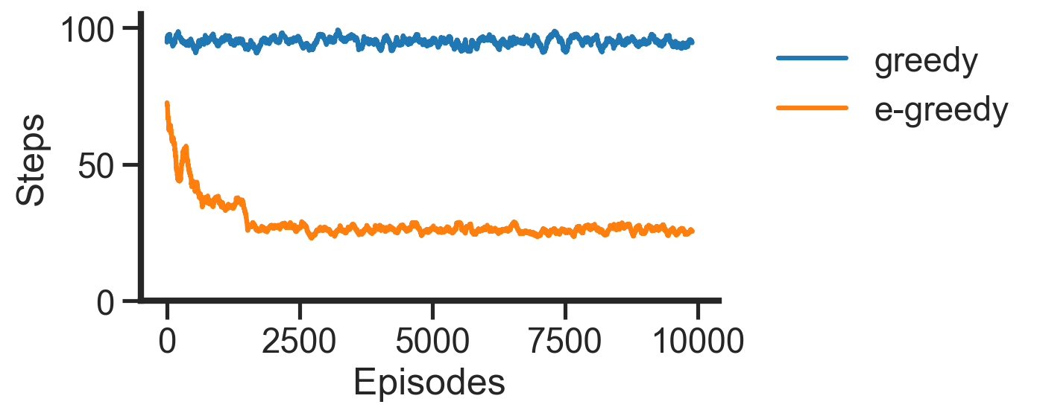
MC control with epsilon-greedy

Slide 14
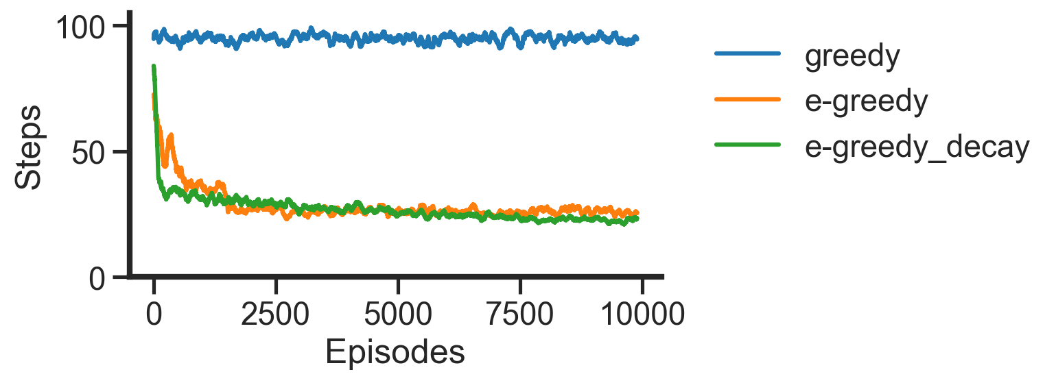
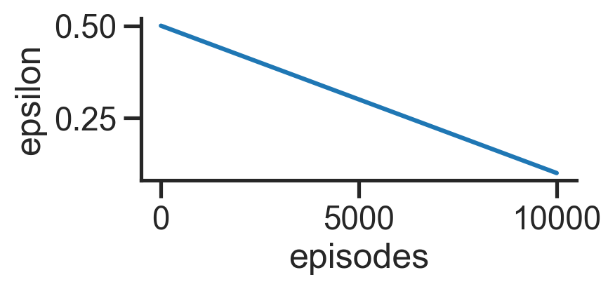
Epsilon-greedy with decay epsilon

Slide 15
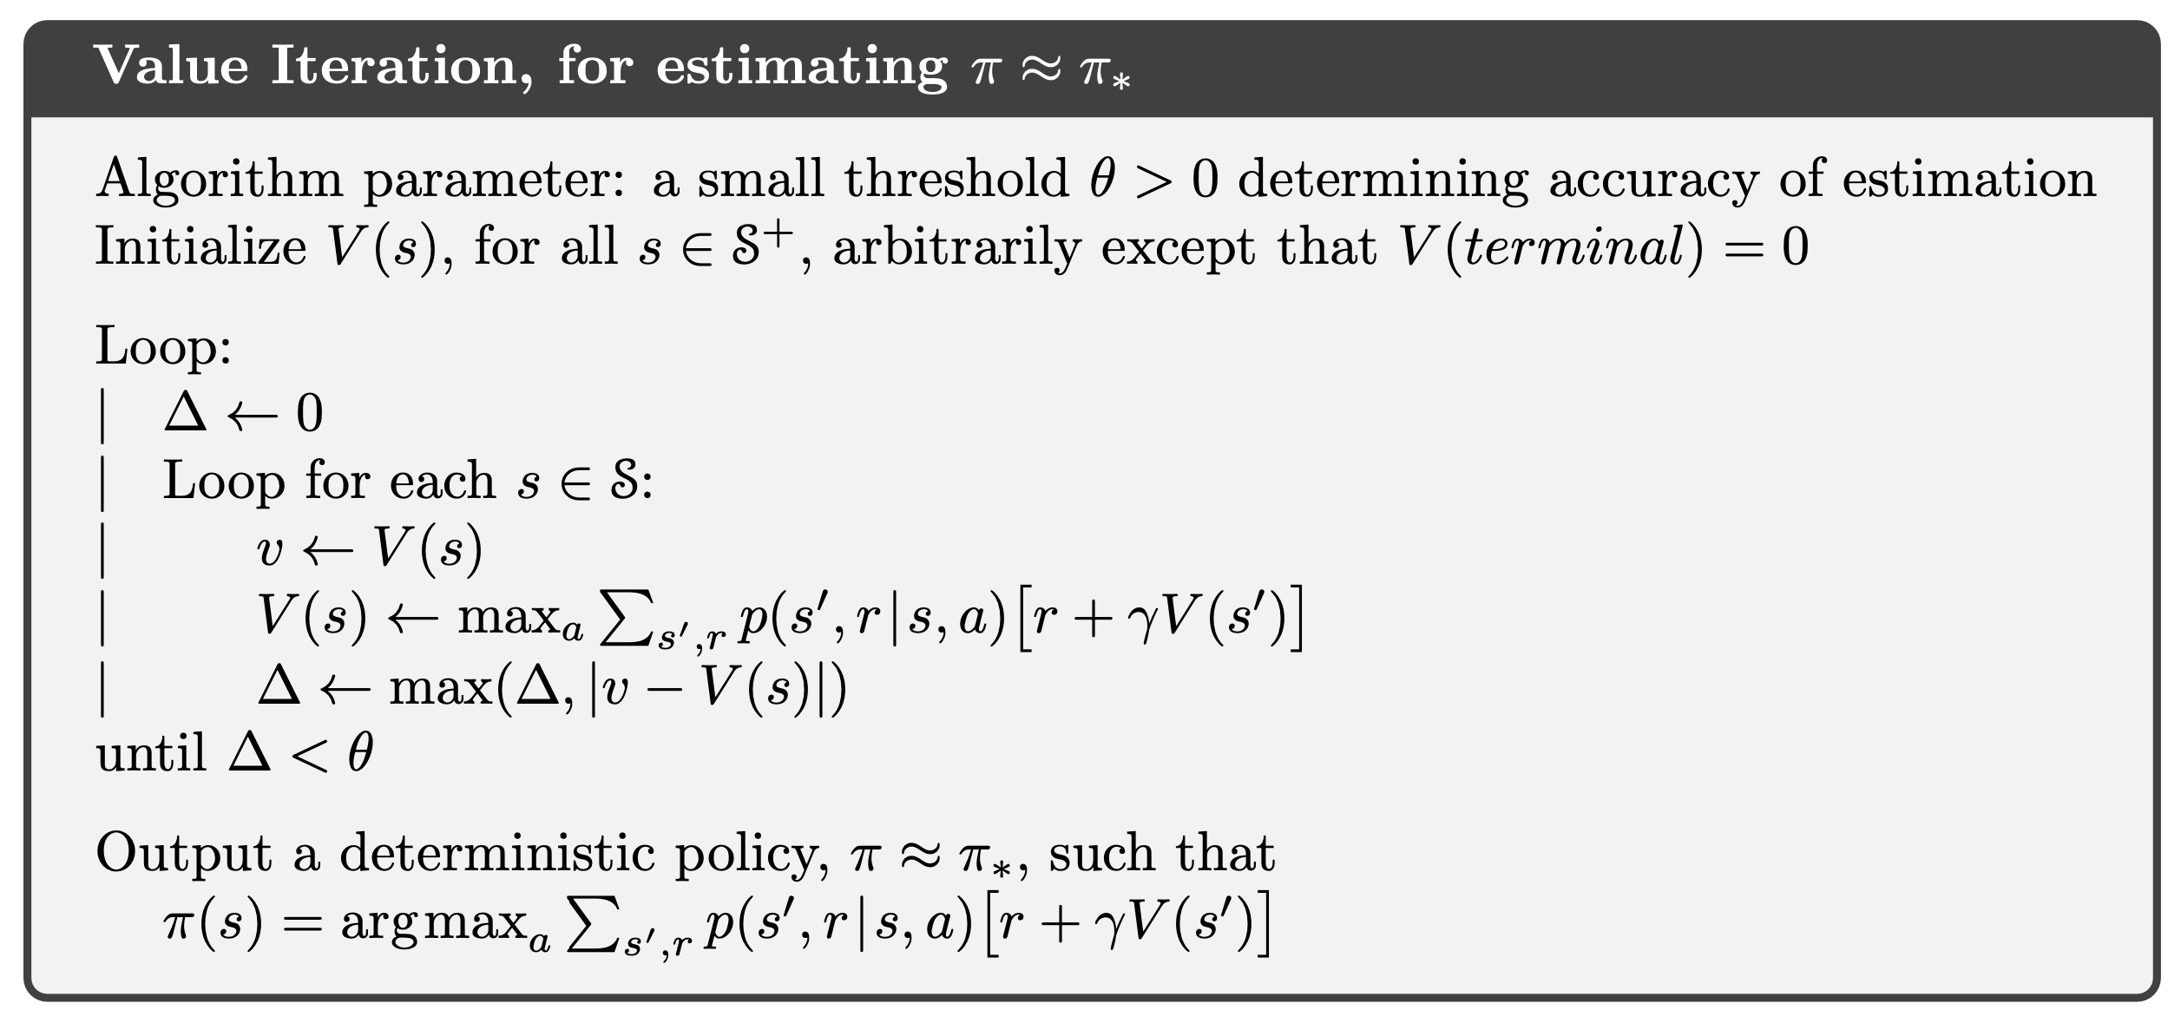
When exploration is needed??

Slide 16
Overview
Lecture
Monte Carlo control
Temporal Difference prediction
Temporal Difference control
Practice MC control
Sarsa
Q learning

Slide 17
Accelerate the MC method
Policy evaluation
Policy improvement
Value iteration
MC prediction
MC control
??

Slide 18
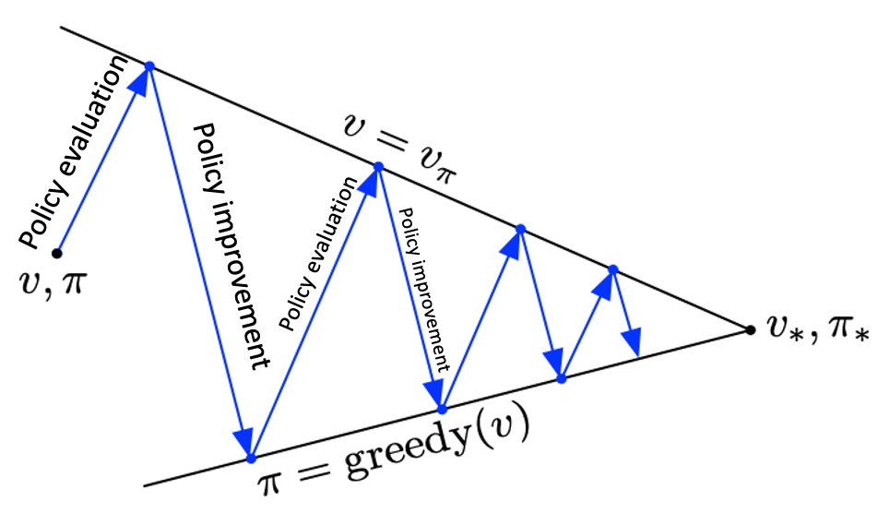
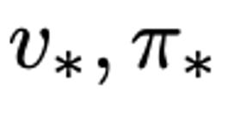
Value iteration
Policy Iteration
Value Iteration

Slide 19
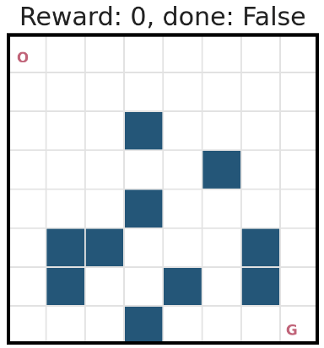
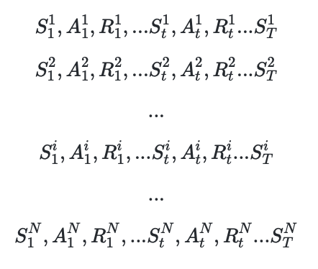
Accelerate the MC method

Slide 20
Temporal Difference method
Online Learning

Slide 21
Temporal Difference method

Slide 22
Temporal Difference method

Slide 23
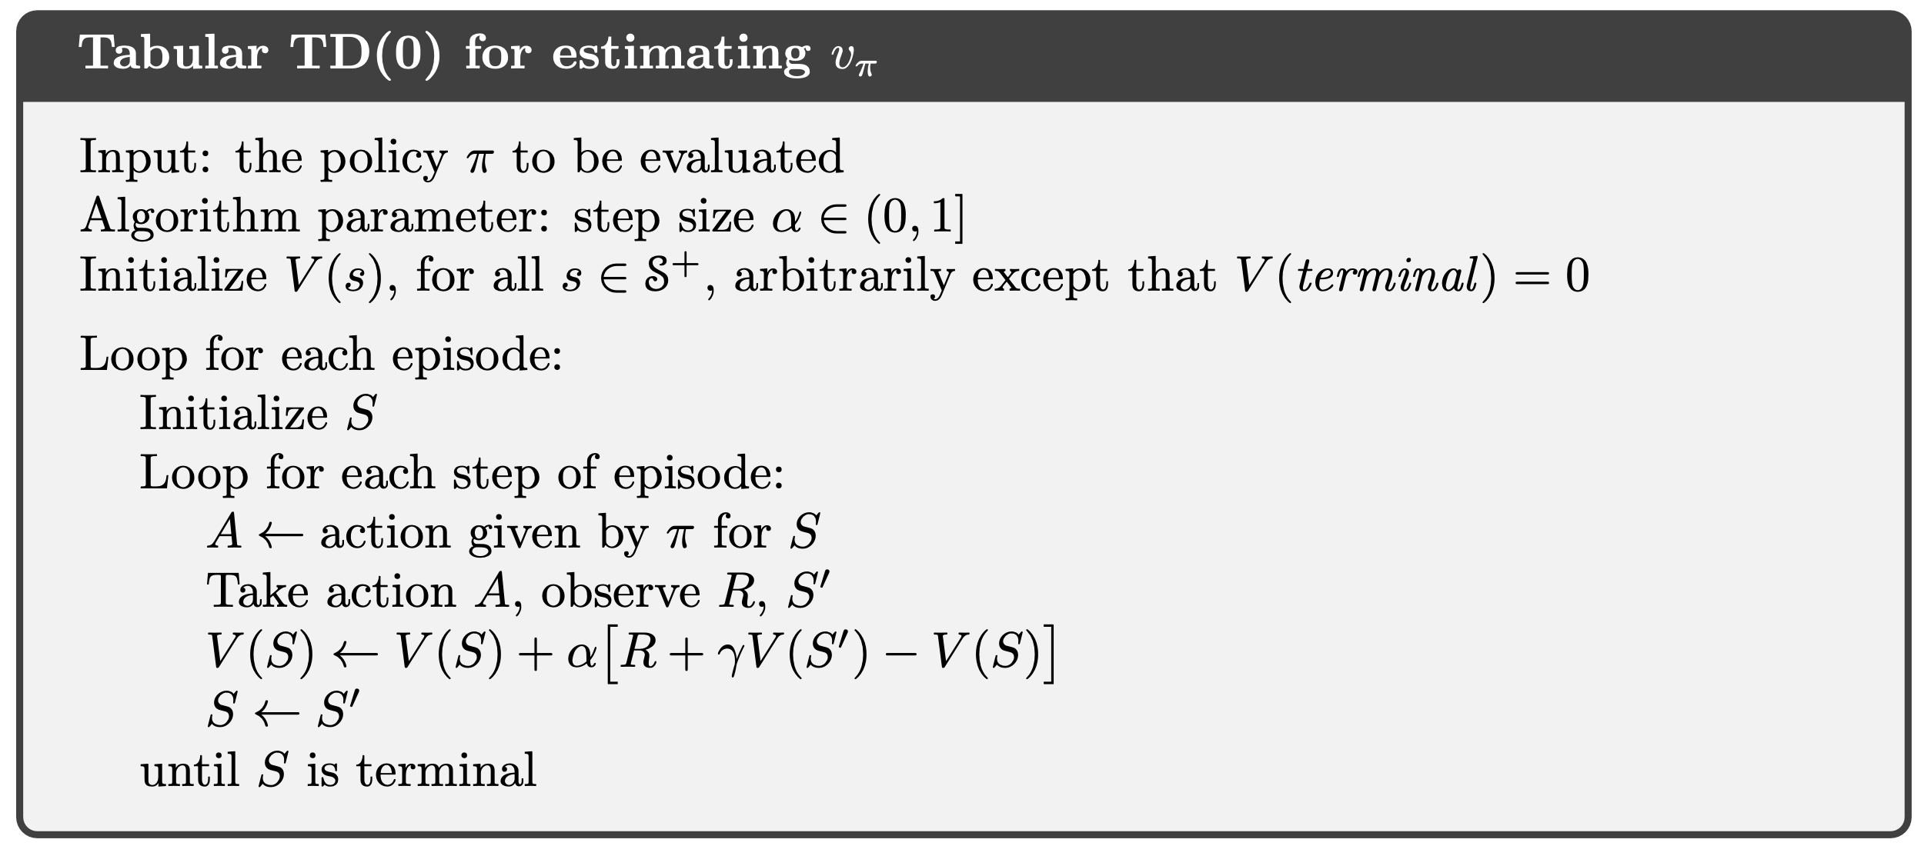
Temporal Difference prediction

Slide 24
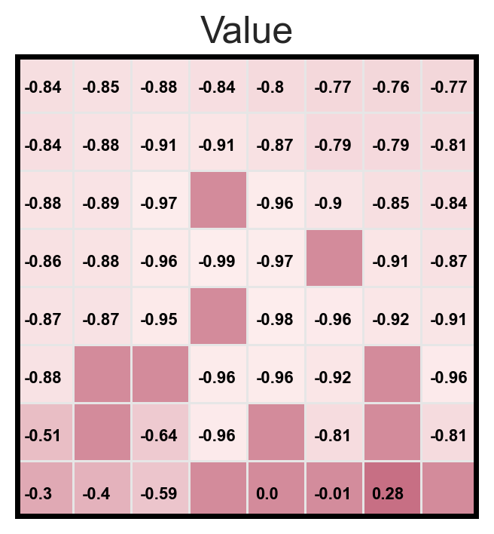
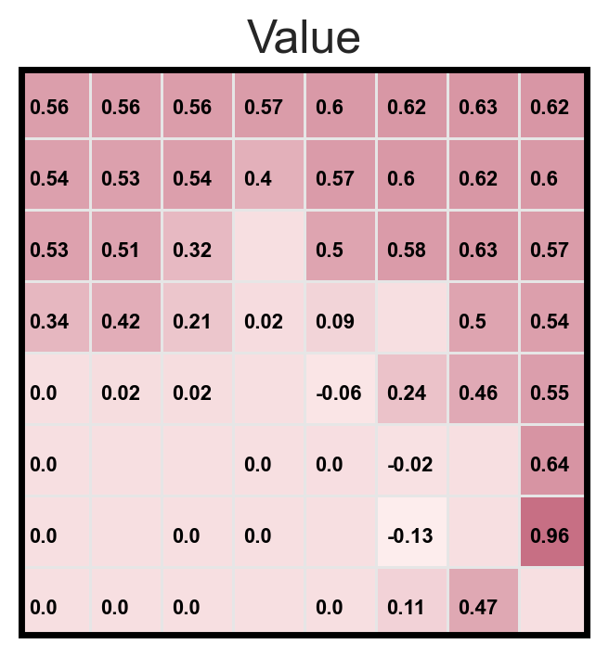
Policy evaluation vs. MC prediction
Policy evaluation
MC prediction
TD prediction
Random policy
Optimal policy

Slide 25
Overview
Lecture
Monte Carlo control
Temporal Difference prediction
Temporal Difference control
Practice MC control
Sarsa
Q learning

Slide 26
More TD variants

Slide 27
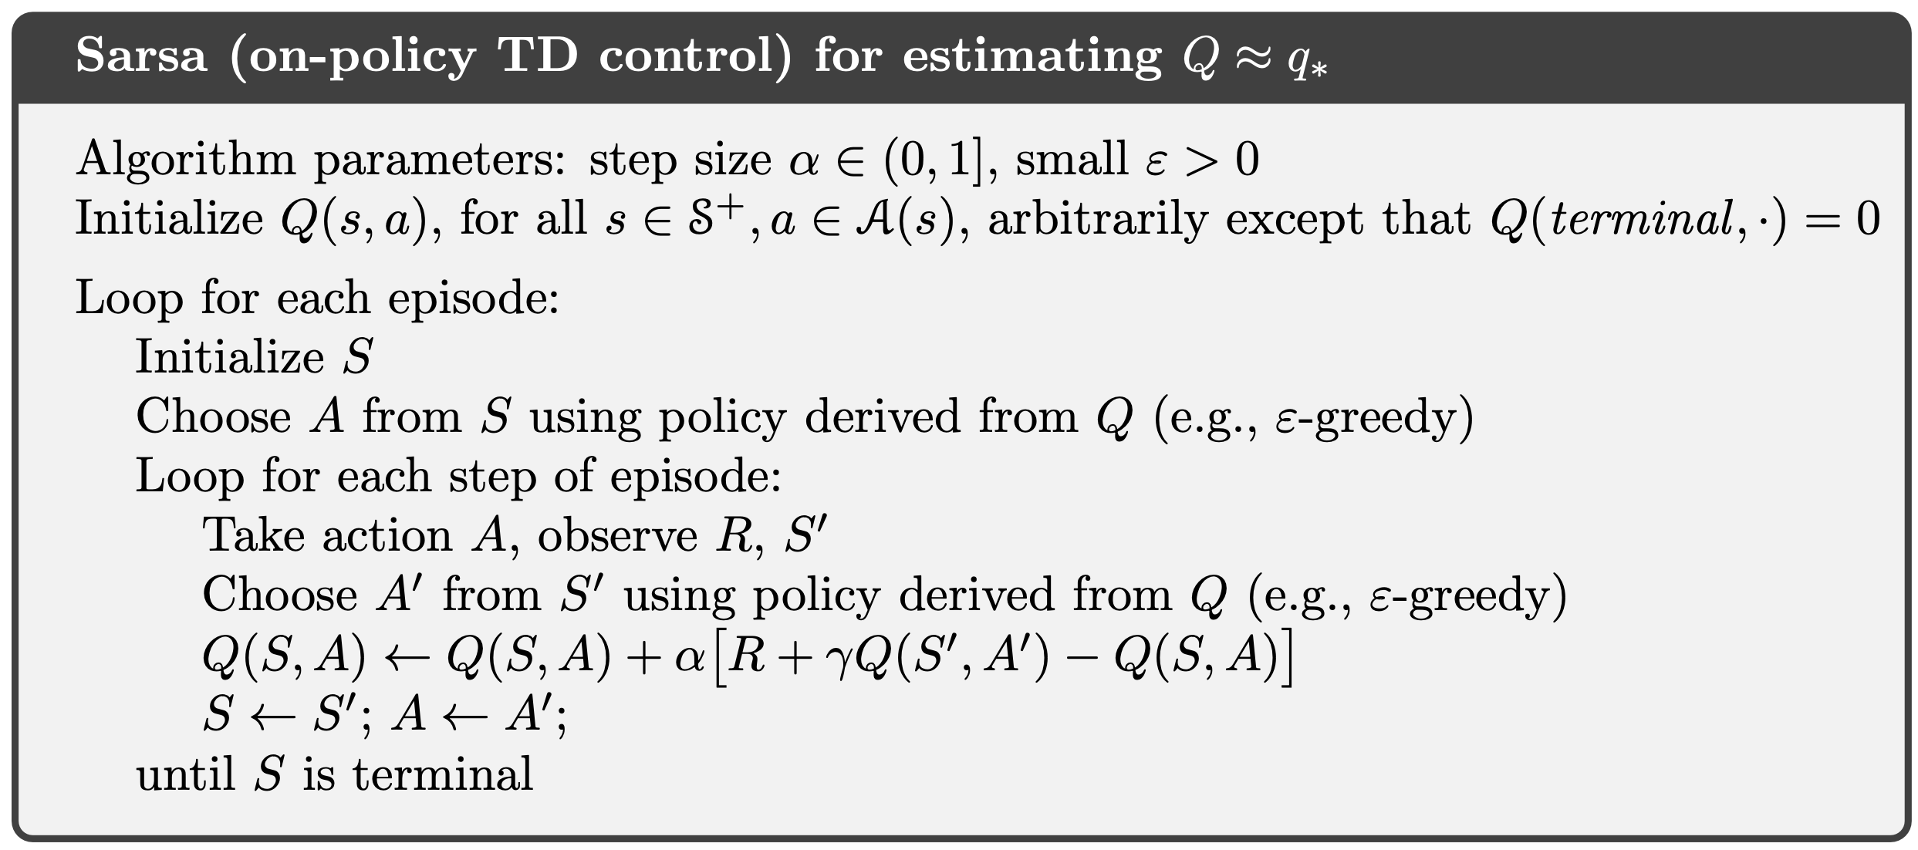
#Practice: Sarsa

Slide 28
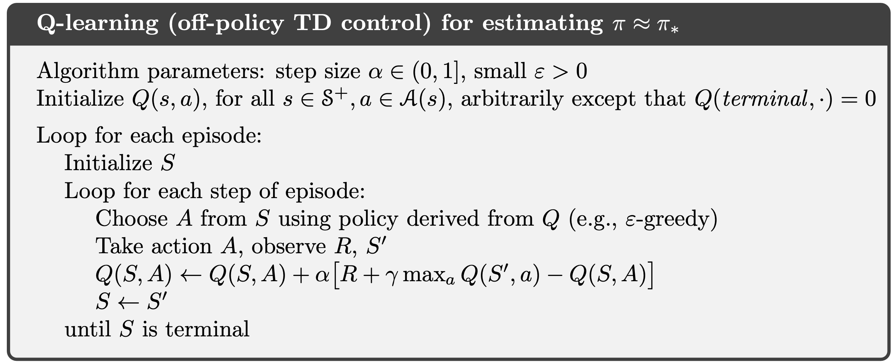
#Practice: Q learning

Slide 29
Definition:
Goal:
Model-based
Model-free
A lack of model
Dynamic Programming
Monte Carlo Method
Policy iteration
Value iteration
Online learning
Temporal Difference learning
Q learning
Sarsa

Slide 30
Overview
Lecture
Policy iteration
Value iteration
Monte Carlo Methods
Practice Policy iteration
Value iteration
Monte Carlo Methods

